Slide 1


Automatic watering for plants presented by B.leelamani

Slide 2
UN SDG’S GOAL
Goal 2. End hunger, achieve food security and improved nutrition and promote sustainable agriculture

Slide 3
INDEX :-
Components
Circuit Diagram
Block diagram
Working
Advantages

Slide 4
Components
Arduino UNO
Soil Moisture Sensor
Motor Water Pump Module 5v
Double Channel Relay Module
Jumper wires
Power Bank

Slide 5
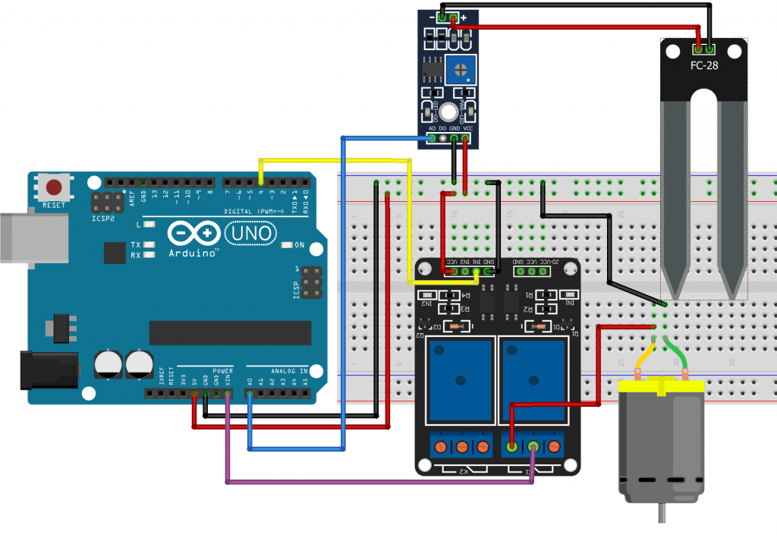
CIRCUIT DIAGRAM :-

Slide 6
Block diagram
Working :-

Slide 7
Acquisition block
This block consists of one soil moisture sensor which takes the data from the soil. It depends on the moisture level of the soil whether to send high or low voltage to the microcontroller to show that it is wet or dry. When the soil is wet, it will send the low output voltage, whereas when it is dry, it will send the high output voltage. This sensor is directly connected to Arduino microcontroller.

Slide 8
Microcontroller block
In this block, Arduino Uno is the microcontroller which is
the core hardware of this project. It receives the input from
the soil moisture sensor and processes the input based on the
requirement coded in the microcontroller.
Automatic Functional block
This block includes the automated watering function of the
system. The automated function consists of two main controlling
hardware, which is relay module and DC watering pump. The
relay is an automatic electric switch that uses an electromagnet
to move the switch from OFF to ON or vice versa.

Slide 9
The switch controls the electric signal that pass through the water pump. When the moisture level is below the threshold level, Arduino sends a signal to the relay module to automatically open the path for the electric to pass through the water pump to water the plant. After the system detects the sufficient level of the water in the soil, the relay will close the path for electric and thus the
water pump will be stop immediately pumping the water.

Slide 10
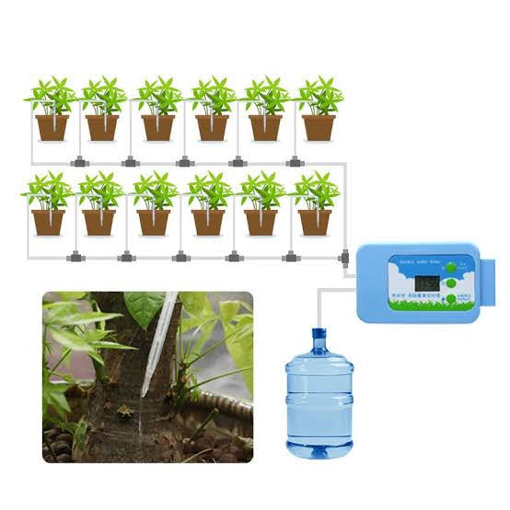

Slide 11
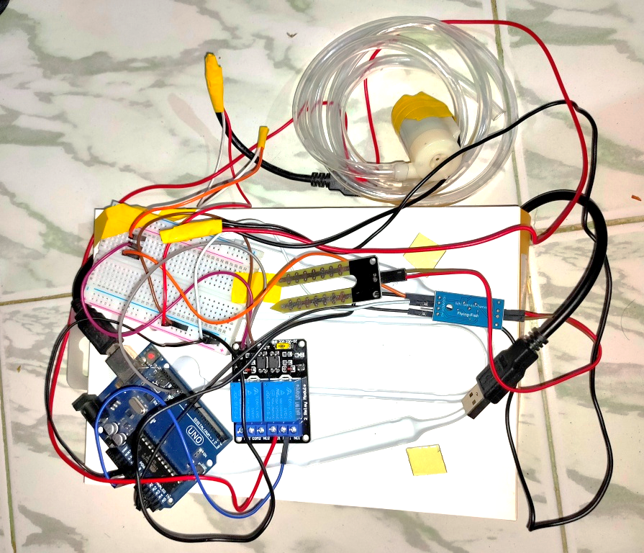
WORKING MODEL :-

Slide 12
Advantages
The automated irrigation system implemented is found to be feasible.
Cost effective for optimizing water resources for agricultural production.
Save water from overflow

Slide 13
Thank you

